Slide 1


Nilesh Bharwad
January 24th 2025

Slide 2
Outline
Executive Summary
Introduction
Methodology
Results
Conclusion
Appendix
2

Slide 3
Executive Summary
Summary of methodologies
Data Collection
Data Wrangling
EDA with Data Visualization
EDA with SQL
Building an interactive map with Folium
Building a Dashboard with Plotly Dash
Predictive Analysis (Classification)
Summary of all results
EDA Results
Interactive Analytics
Predictive Analysis
3

Slide 4
Introduction
Project background and context
SpaceX advertise Falcon 9 rocket launches on the website, with a cost of 62 million dollars; other provides cost upward of 165 million dollars each, much of the saving is due to reusable rockets in the first stage of launch.
Problems you want to find answers
The project task is to predict weather the first stage of each launch of Falcon 9 rocket will land successfully or not.
4

Slide 5

Section 1
5

Slide 6
Methodology
Executive Summary
Data collection methodology:
SpaceX Rest API
Web Scrapping from Wikipedia
Perform data wrangling
One Hot Encoding data fields for Machine Learning data cleaning null values, and irrelevant columns
Perform exploratory data analysis (EDA) using visualization and SQL
Perform interactive visual analytics using Folium and Plotly Dash
Perform predictive analysis using classification models
LR, KNN, SVM and DT models have been built and evaluated for the best classifier
6

Slide 7
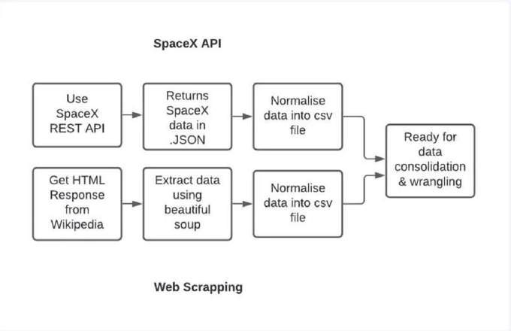
Data Collection
The Following datasets were collected:
SpaceX launch data that is gathered from the SpaceX Rest API.
This API will give us data about launches, including information about the rocket used, payload delivered, launch specifications, landing specifications, and landing outcomes.
The SpaceX REST APO endpoints, or URLs, starts with api.spacexdata.com/v4/.
Another Popular data course for obtaining Falcon 9 launch data is web scrapping from www.Wikipedia.com using BeautifulSoup method.
7

Slide 8
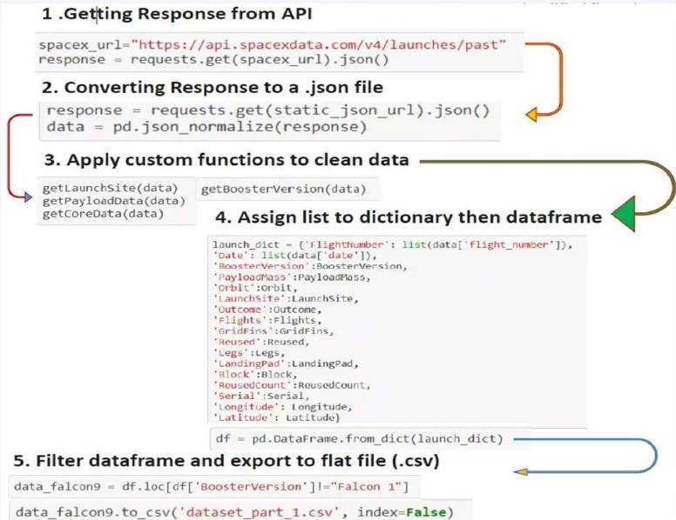
Data Collection – SpaceX API
Data Collection with SpaceX Rest API calls.
nbharwad/IBM_Data_Science_Certificate: IBM Data Science Certificate.

Slide 9
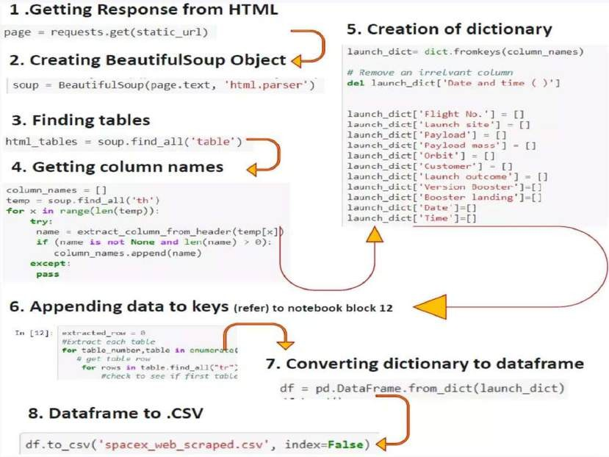
Data Collection - Scraping
Web Scrapping from Wikipedia
IBM_Data_Science_Certificate/jupyter-labs- webscraping.ipynb at main · nbharwad/IBM_Data_Science_Certificate

Slide 10
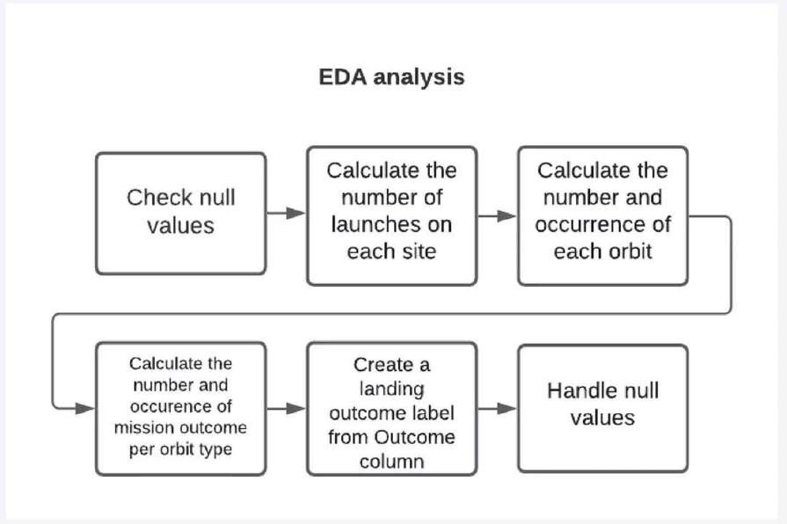
Data Wrangling
IBM_Data_Science_Certificate/labs-jupyter-spacex-Data wrangling.ipynb at main · nbharwad/IBM_Data_Science_Certificate
10

Slide 11
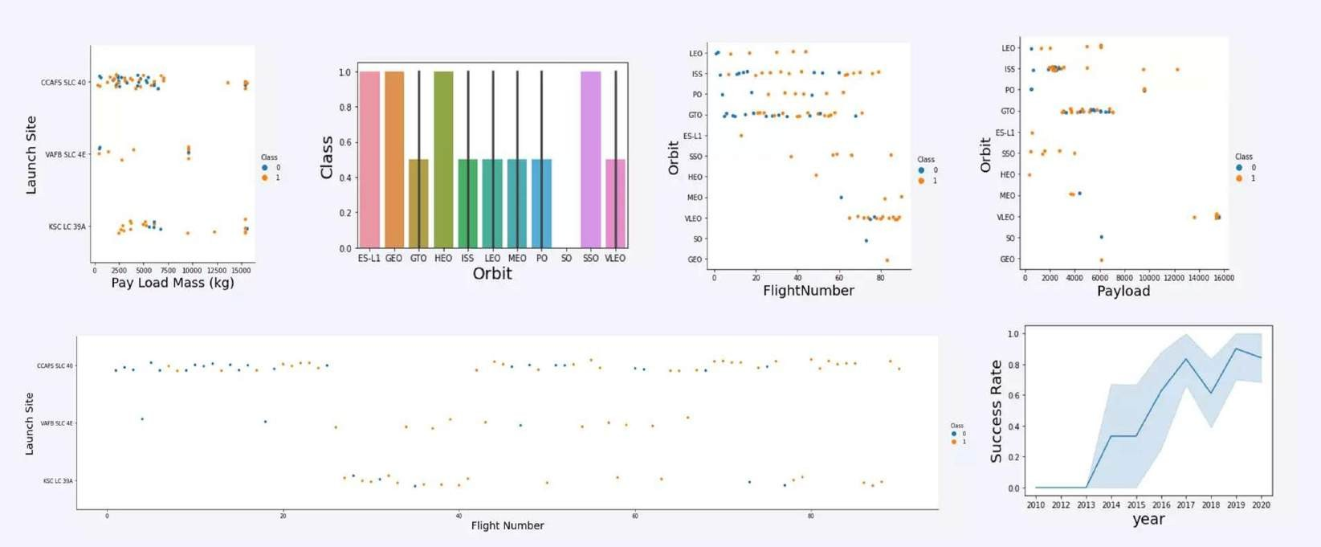
EDA with Data Visualization
nbharwad/IBM_Data_Science_Certificate: IBM Data Science Certificate.

Slide 12
EDA with SQL
Displaying the names of the unique launch sites in the space mission
Displaying 5 records where launch sites begin with the string ‘KSC’
Displaying the total payload mass carried by boosters launched by NASA (CRS)
Displaying average payload mass carried by booster version F9 v1.1
Listing the date where the successful landing outcome in drone ship was achieved
Listing the names of the boosters which have success in ground pad and have payload mass between 4,000 and6,000
Listing the total number of successful and failure mission outcomes
Listing the names of the booster_versions which have carried the max. payload mass.
Listing the records which will display the month names, successful landing outcomes in ground pad, booster versions, lannch site for the months in year 2017
Ranking the count of successful landing outcomes between the dates 2010 and 2017.
Link: IBM_Data_Science_Certificate/jupyter-labs-eda-sql-coursera_sqllite.ipynb at main · nbharwad/IBM_Data_Science_Certificate

Slide 13
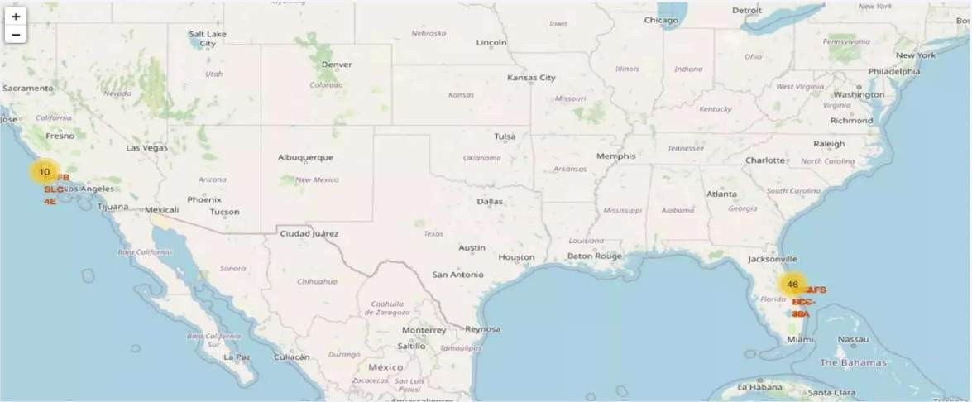
Build an Interactive Map with Folium
Map Markers have been added to the map with aim to finding an optimal location for building a launch site. IBM_Data_Science_Certificate/Interactive Visual Analytics with Folium.ipynb at main · nbharwad/IBM_Data_Science_Certificate

Slide 14
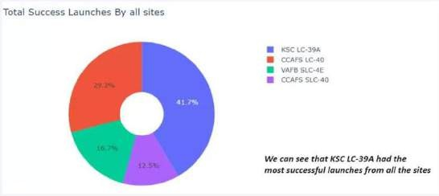
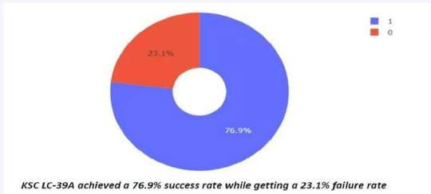
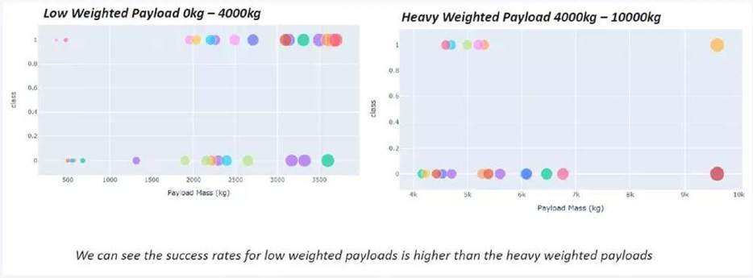
Build a Dashboard with Plotly Dash
IBM_Data_Science_Certificate/8) dash_interactivity.py at main · nbharwad/IBM_Data_Science_Certificate
14

Slide 15
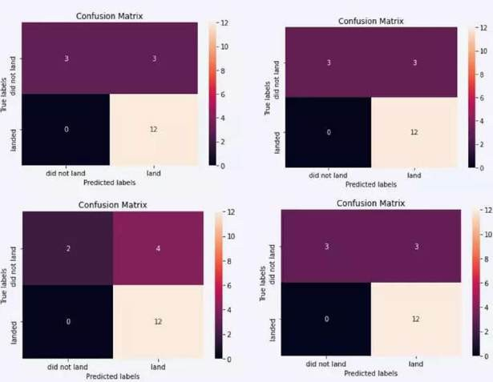
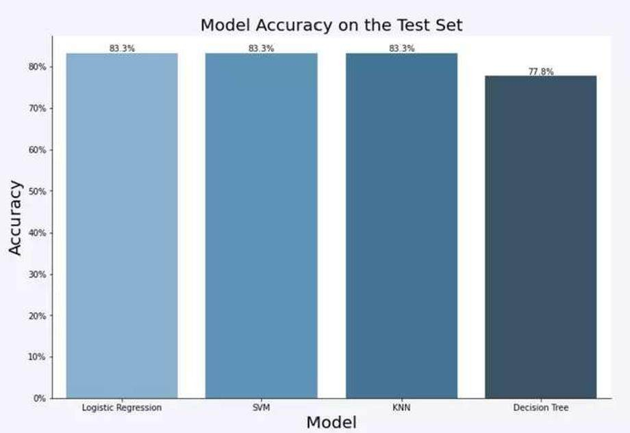
Predictive Analysis (Classification)
The SVM, KNN, and LR model achieved the highest accuracy i.e. 83.3%, while the SVM performs the best in terms of Area Under the curve at 0.958
IBM_Data_Science_Certificate/Machine Learning Prediction.ipynb at main · nbharwad/IBM_Data_Science_Certificate

Slide 16
Results
The SVM, KNN and LR models are the best in terms of prediction accuracy for this dataset.
Low weighted payloads performs better than the heavier payloads
The success rates for SPACEX launches is directly proportional time in years they will eventually perform
the launches. KSC LC 39A had the most successful launches from all the sites.
Orbit GEO, HEO, SSO, ES L1 has the best success rate.

Slide 17

Section 2

Slide 18
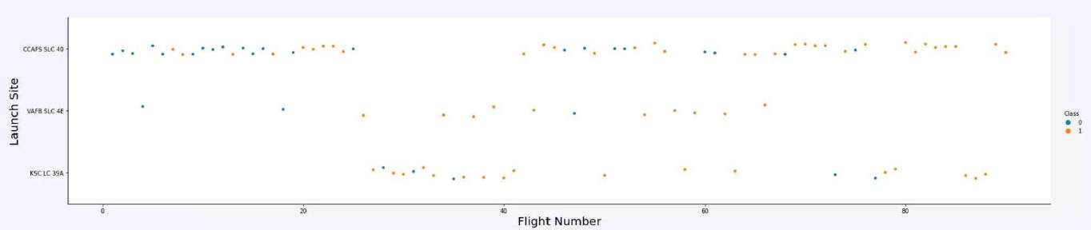
Flight Number vs. Launch Site
Launches from the site of CCAFS SLC 40 are significantly higher than launches from other sites.

Slide 19
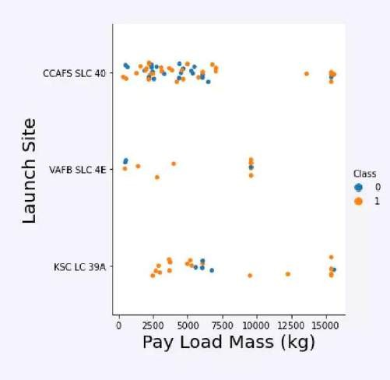
Payload vs. Launch Site
The Majority of payloads with lower Mass have been launched from CCAFS SLC 40.

Slide 20
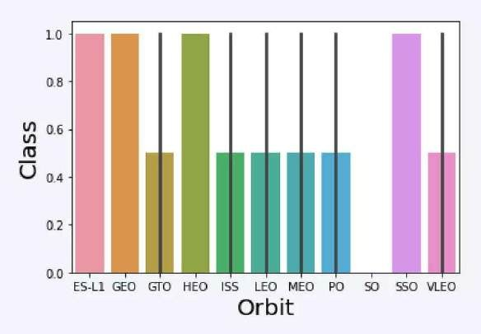
Success Rate vs. Orbit Type
The orbit of ES-L1, GEO, HEO, SSO are among the highest success rate.

Slide 21
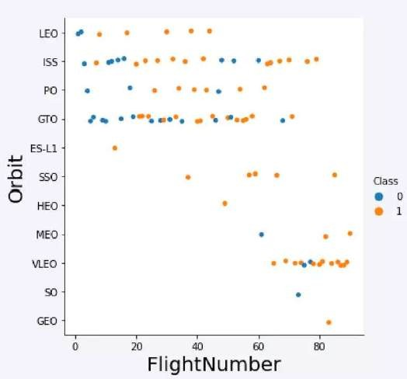
Flight Number vs. Orbit Type
A trend can be observed of shifting to VLEO
launches in recent years.

Slide 22
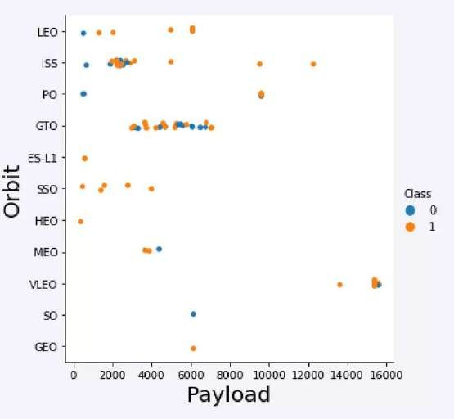
Payload vs. Orbit Type
There are strong correlation between ISS and payload at the range around 2000, as well as between GTO and the range between 4,000 and 8,000.

Slide 23
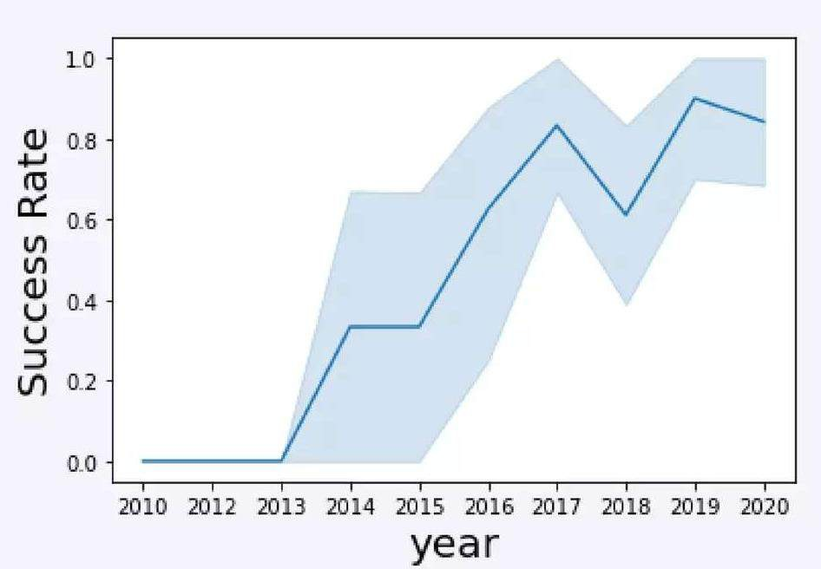
Launch Success Yearly Trend
Launch success rate has increased significantly since 2013 and has stabilised since 2010 and potentially due to advance in technology and lessons learned.

Slide 24
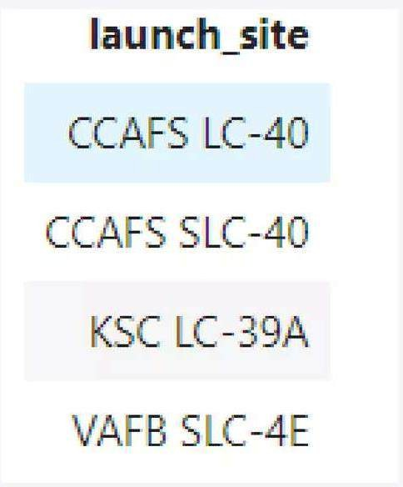
All Launch Site Names

Slide 25
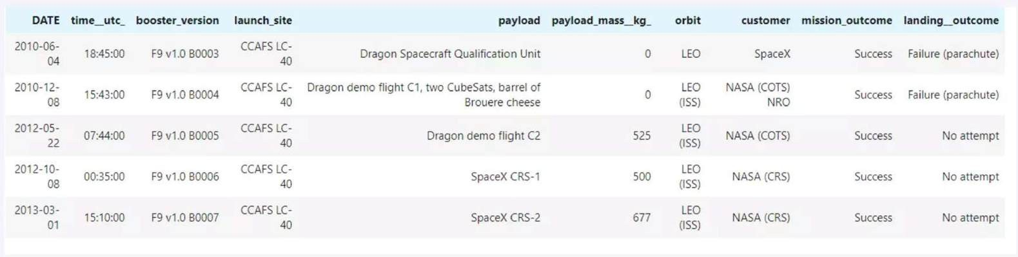
Launch Site Names Begin with 'CCA'
%sql select * from SPACEXTBL where LAUNCH_SITE like 'CCA%' limit 5

Slide 26
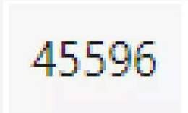
Total Payload Mass
%sql select sum(PAYLOAD_MASS_KG) from SPACEXTBL where CUSTOMER = 'NASA (CRS)'

Slide 27
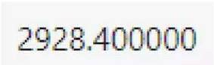
Average Payload Mass by F9 v1.1
%sql select avg(PAYLOAD_MASS_KG) from SPACEXTBL where BOOSTER_VERSION = 'F9V1,1'

Slide 28
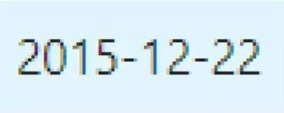
First Successful Ground Landing Date
%sql select min(DATE) from SPACEXTBL where Landing_Outcome = 'Success (ground pad)'

Slide 29
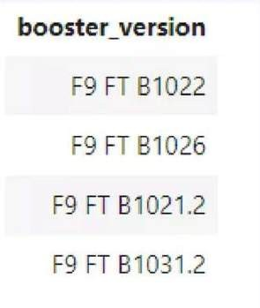
Successful Drone Ship Landing with Payload between 4000 and 6000
%sql select BOOSTER_VERSION from SPACEXTBL where Landing_Outcome = 'Success (drone ship)' and
PAYLOAD_MASS_KG_ > 4000 and PAYLOAD MASS KG_ < 6000

Slide 30

Total Number of Successful and Failure Mission Outcomes
%sql select count(MISSION_OUTCOME from SPACEXTBL where MISSION_OUTCOME = 'Success' or MISSION_OUTCOME = 'Failure (in flight)'

Slide 31
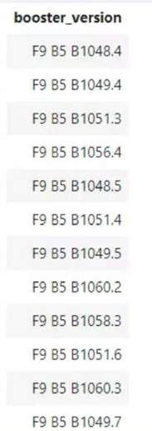
Boosters Carried Maximum Payload
%sql select BOOSTER_VERSION from SPACEXTBL where PAYLOAD_MASS_ KG_ = (select max PAYLOAD_MASS_KG_) from
SPACEXTBL)

Slide 32
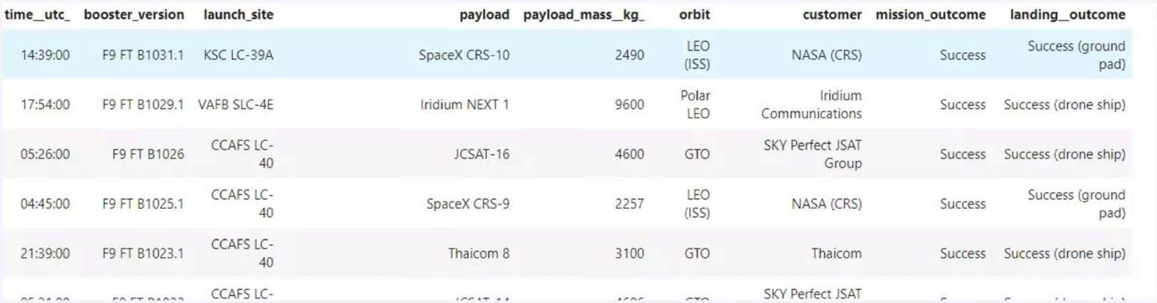
2015 Launch Records
%sql select * from SPACEXTBL where Landing_Outcome like 'Success%' and (DATE between '2015- 01-01' and '2015-12-31') order by date desc

Slide 33
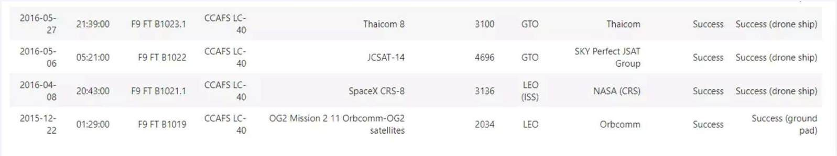
Rank Landing Outcomes Between 2010-06-04 and 2017-03-20
%sql select from SPACEXTBL where Landing Outcome like 'Success%' and (DATE between '2010-06-04'
and '2017-03-20') order by date desc

Slide 34

Section 3

Slide 35
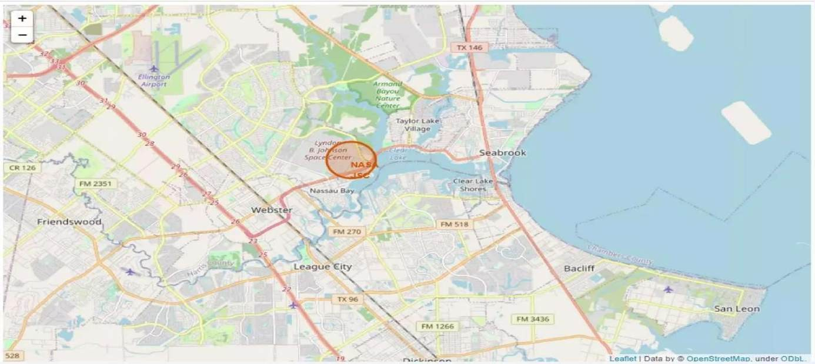
Marked launch sites on map!

Slide 36
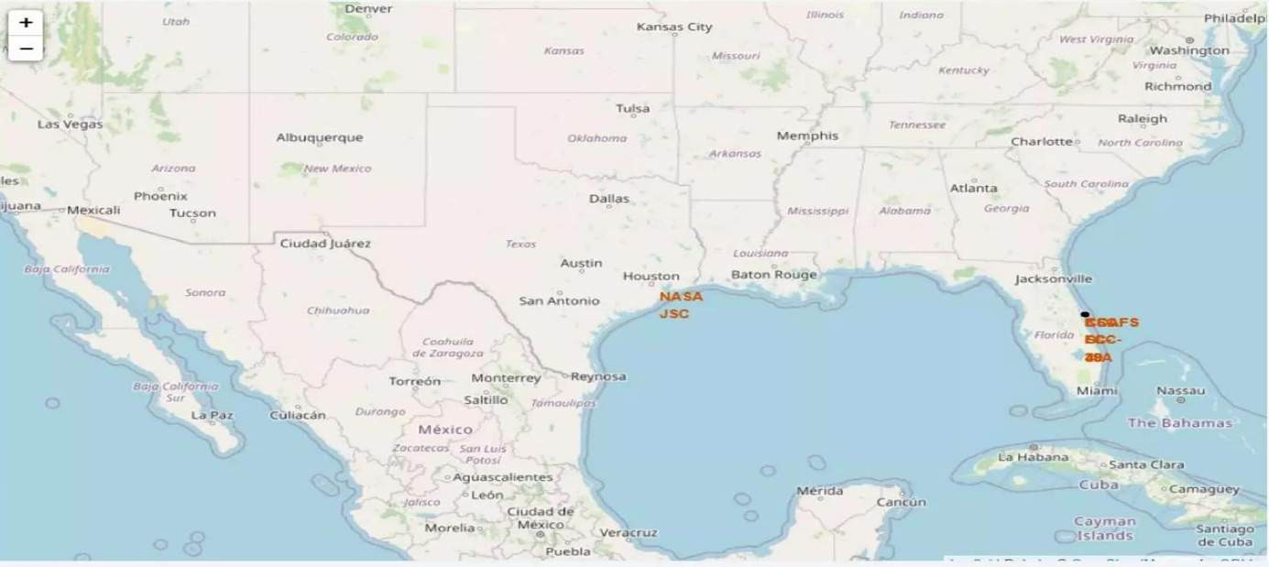
Success/Failed Launch Sites Marked on the Map!

Slide 37
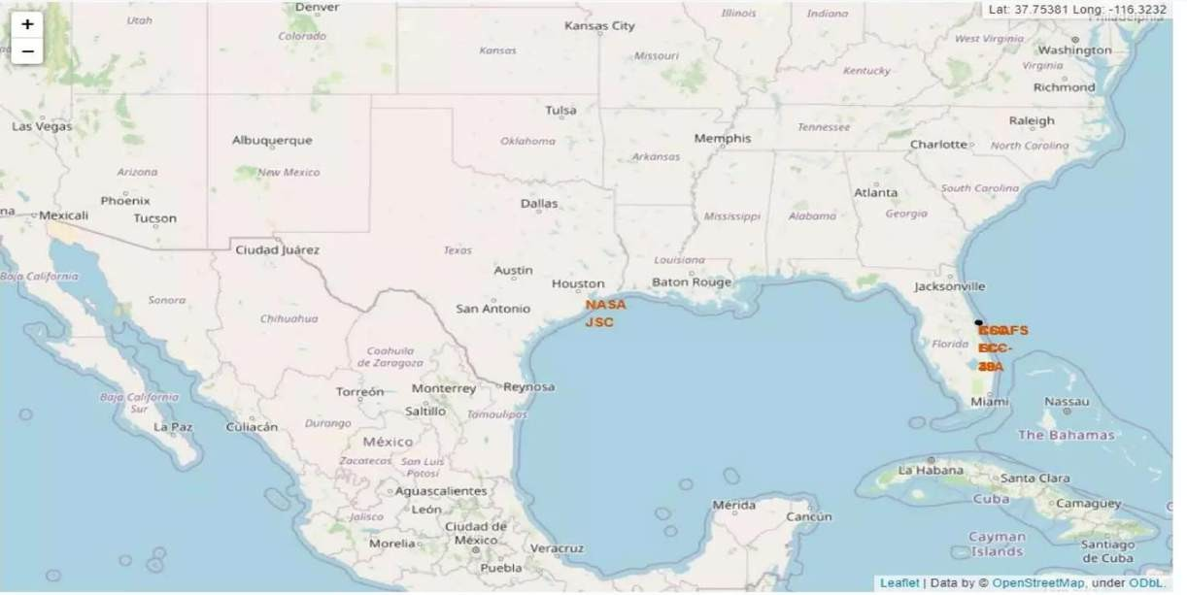
Distance between launch sites to it’s proximity

Slide 38

Section 4

Slide 39

Total Success Launches by all sites!

Slide 40
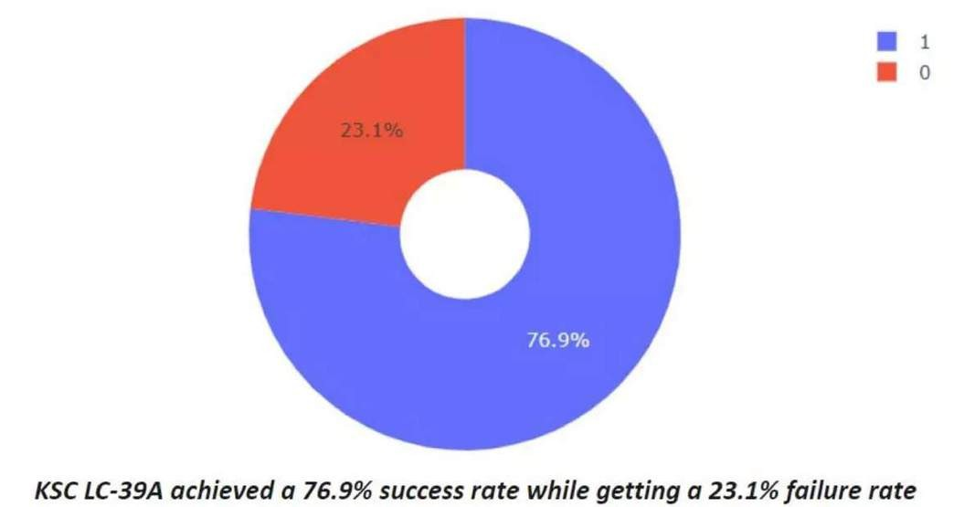
Success rate by site!

Slide 41
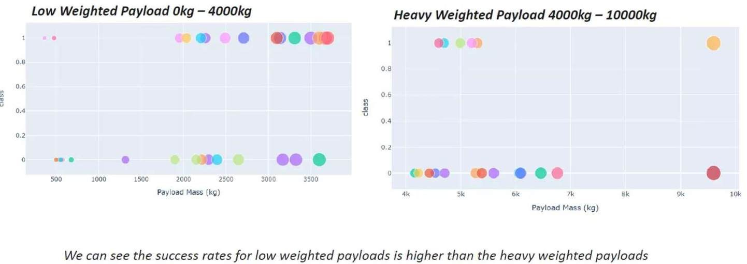
Payload vs Launch outcome!

Slide 42

Section 5

Slide 43
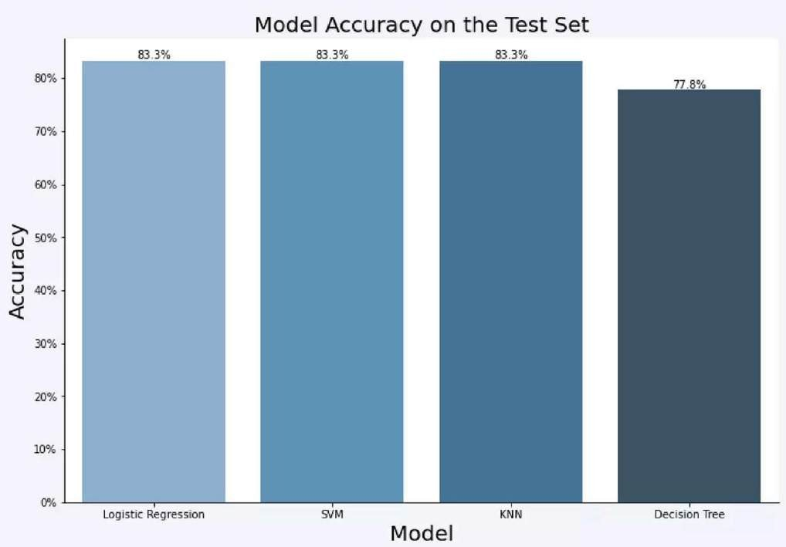
Classification Accuracy
Model Accuracy!

Slide 44
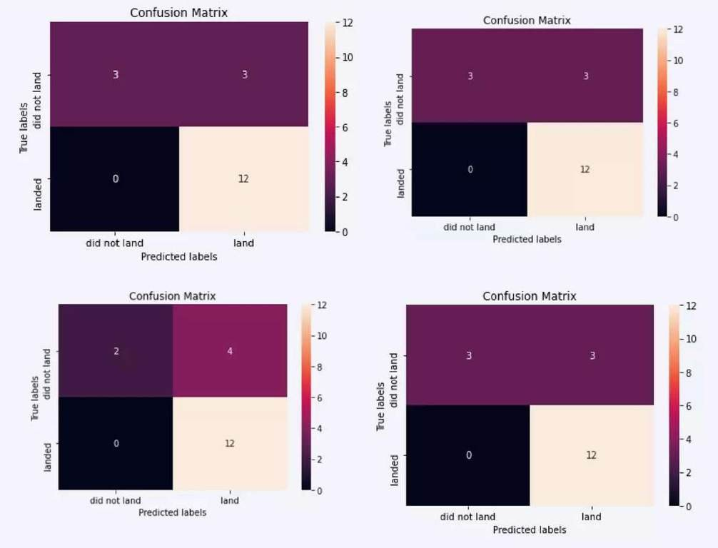
Confusion Matrix

Slide 45
Conclusions
The SVM, KNN, and Logistic Regression models are the best in terms of predction accuracy for this dataset.
Low weighted payloads perform better than the heavier payloads.
The success rates for SpaceX launches is directly proportional time in years they will eventually perfect the launches.
KSC LC 39A had the most successful launches from all the sites.• Orbit GEO,HEO,SSO,ES L1
has the best Success Rate.

Slide 46
Appendix
nbharwad/IBM_Data_Science_Certificate: IBM Data Science Certificate.

Slide 47
